Slide 1
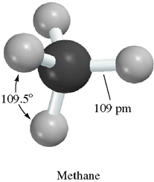
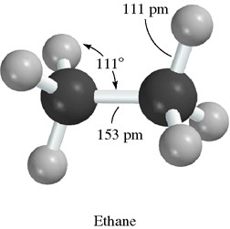
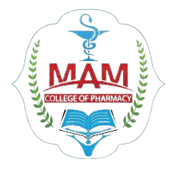
UNIT- 2
Alkanes*, Alkenes* and Conjugated dienes*
Mr. ALETI VAMSI
ASSISTANT PROFESSOR
DEPT. OF PHARMACEUTICAL CHEMISTRY
M.A.M COLLEGE OF PHARMACY

Slide 2
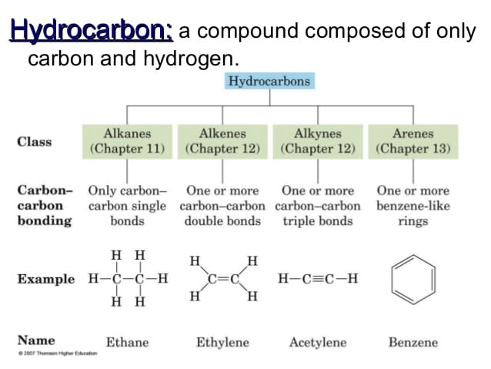

Slide 3
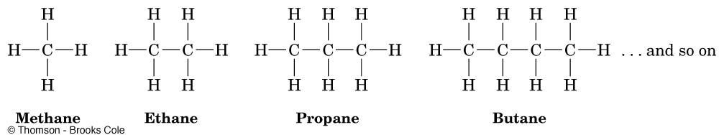
Alkanes:
alkanes are the simplest class of organicc compounds. They are made up of carbon and hydrogen atoms only and contains two type of bonds, carbon-hydrogen (C-H) and carbon-carbon (C-C) single covalent bonds. They do not have functional groups.
these componds also known as saturated hydrocarbons. These are aliphatic compounds
alkanes another name is paraffins (low affinity compounds) because they do not react as most chemicals
The general formula for an alkane is C_{n}H_{2n+2} where n: 1,2,3,4….

Slide 4
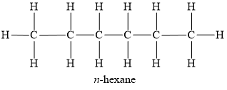
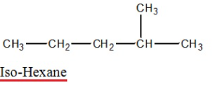
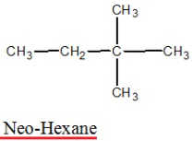
The no. of side chain will be grouped in ascending order and written before the name of the side
ex: n= normal or straight chain
2. Iso : methyl group attached to second last carbon
3. Neo : Two methyl group attached to second last carbon

Slide 5
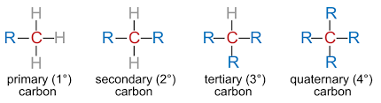
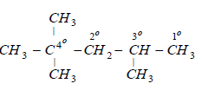
4. Alkane structure contain from types of carbon
Primary carbon - 1º => Attach to 1 or no. of carbons
Secondary carbon - 2º => Attach to 2 other carbons
Tertiary carbon - 3º => Attach to 3 other carbons
Quaternary carbon - 4º => Attach to 4 other carbons
Ex:
5. The Alkane group is a formate by removable of one hydrogen atoms from alkane
Ex:
R-H
- H
R
(R= ALKYL GROUP)
CH3-H
- H
CH3
METHYL

Slide 6
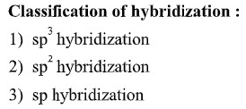

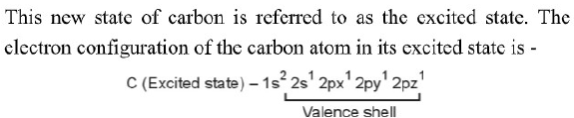
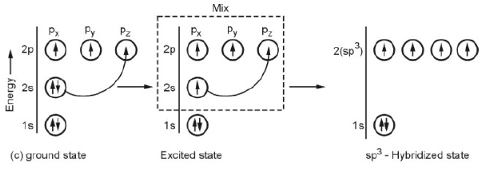
Hybridization
Mixing of atomic orbitals of equal energy to form an equal number of new orbitals which have equal energy , identical shape and size are symmentrically oriented in space. The new orbitals formed are called hybrid orbitals.
Sp3 hybridization of alkanes:

Slide 7
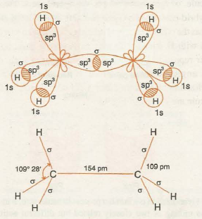
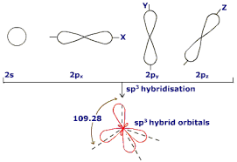
Each sp3 hybrid orbitals has 25% S and 75% P character.
1S and 3P orbitals combine to form four equelent hybrid orbitals. These four hybrid orbitals are directed towards the corners of a regular tetrahedral. This type of hybridization is known as tetrahedral hybridization.
All saturated compounds of carbon such as alkanes involves sp3 hybridization.
Ex: ethane
Overlap with one sp3 to other sp3 hybridization to form c-c sigma bond.

Slide 8
Uses of alkanes or paraffins:
Methane ,ethane, propane and butane are used for heating, cooking and electricity generations
Methane and ethare are natural gases.
Its used as fuel and good solvents
Above 17 carbon atoms alkane are the main components of lubricants oil and fuel oil.
Many solid alkanes uses as paraffin wax.
Ethane is used as refrigerator systems. Its manufacture of plastic, automotive antifreeze and detergents.
Pentane is active ingredient of pesticides and also used as liquid chromatography.
Hexane is used for leather products and shoes.
heptane is used in paints
halothane is used as general anaesthetics.

Slide 9
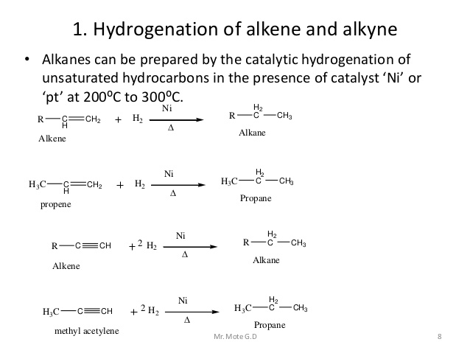

Slide 10
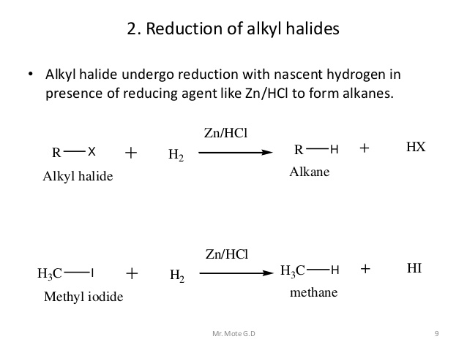

Slide 11
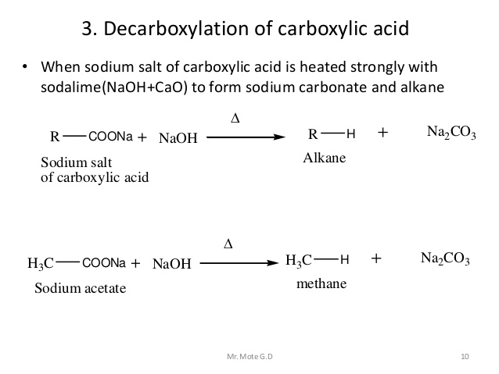
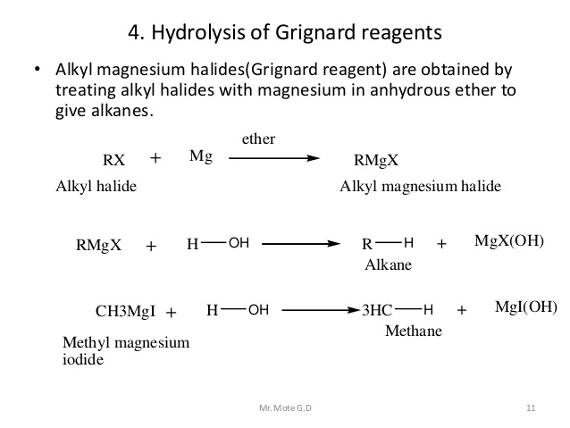

Slide 12
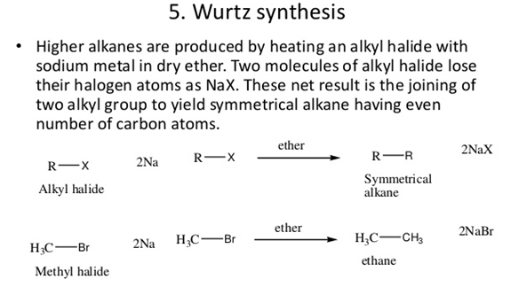

Slide 13
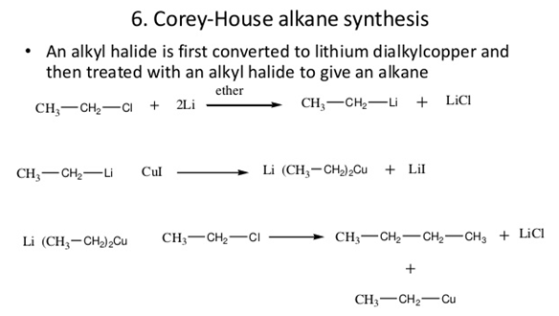
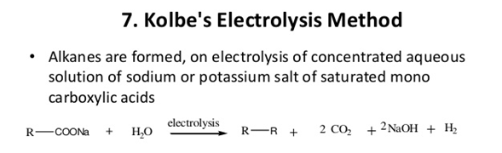

Slide 14
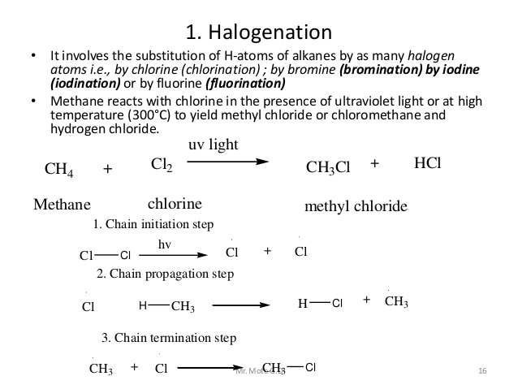
Reactions of alkanes

Slide 15
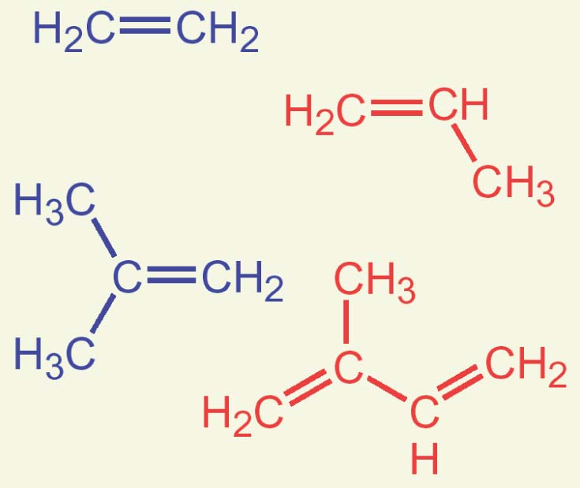
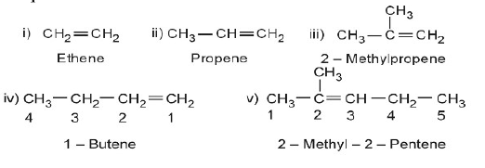
Alkenes:
Alkenes are the class of organic compounds. They are made up of carbon and hydrogen atoms only and contains carbon-carbon (C=C) double bonds. They do not have functional groups.
These compounds also known as unsaturated hydrocarbons.
Alkenes another name is olefins (oil forming)
Suffix “-ene”
They are also called Ethylenic hydrocarbons
Many Alkenes Are Known by Common Names
Ethylene = ethene
Propylene = propene
Isobutylene = 2-methylpropene
Isoprene = 2-methyl-1,3-butadiene
The general formula of alkene is C_{n}H_{2n} where n: 1,2,3,4….

Slide 16

Physical properties of alkenes
C1-C4 gases
C5-C18 liquids
More than C18 solids
Alkenes are nonpolar compounds. Thus alkenes are soluble in the nonpolar solvents such as carbon tetrachloride (CCl4) and benzene (C6H6), but they are insoluble in polar solvents such as water.
Alkenyl group:
Removal of one hydrogen atom from alkenes are called alkenyl group
CH2=CH- vinyl group
CH2=CHCH2 - allyl group
Uses of alkenes or olifins:
alkenes are used in manufacturing of plastic.
These are used as raw material for the manufacture of industrial chemicalslike alcohols, aldehyde etc.
Used as general anaesthetics
Propene used in synthesis of vinegar, propanol, and glycerine, acetone, phenol etc,
Its production of other chemical

Slide 17
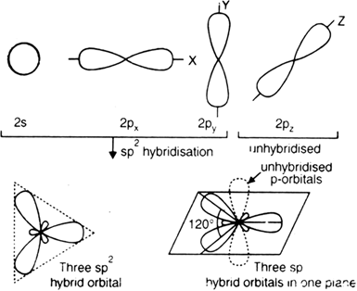
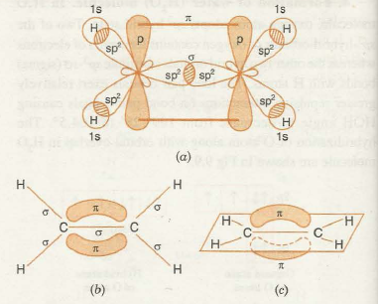
Sp2 hybridization of alkenes:
1S and 2P orbitals combine to form sp2 hybrid orbitals.
sp2 hybrid orbital has 33% s and 67% p character
the 3 sp2 hybrids point towards the corners of a triangle at 120º to each other
These three sp2 orbitals that is in a plane and directed towards the three corners of a equilateral triangle so this hybridization is known as trigonal hybridization.
a double bond as a σ+ π bond
Ex: ethene
Bond length --------1.34Å,
H-C-H Bond length --------117.5Å
C-H Bond length --------1.09Å,
C-C-H Bond length --------121Å

Slide 18
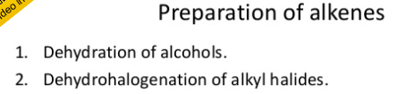
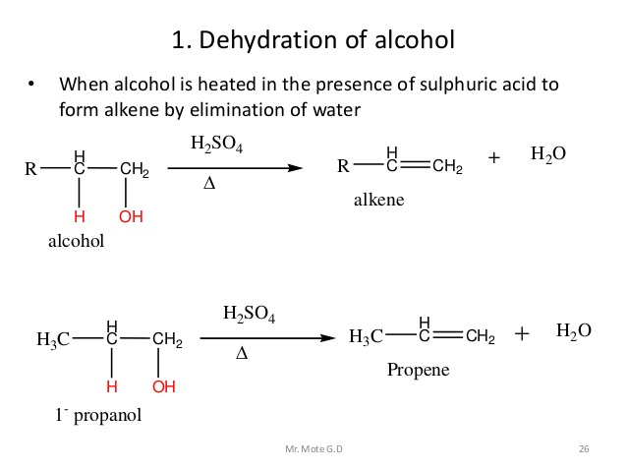

Slide 19
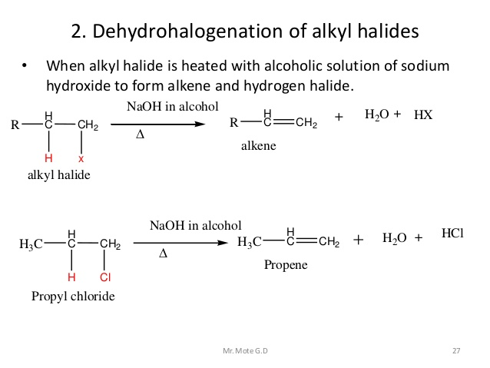

Slide 20

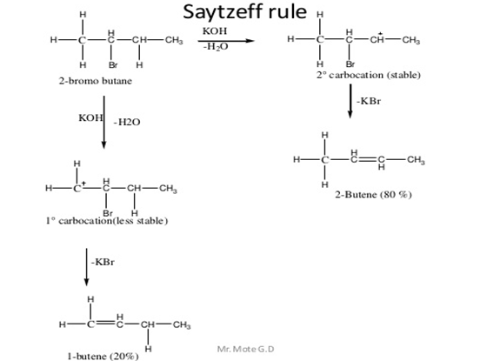
Dehydrohalogenation of alkyl halide (saytzeff rule)

Slide 21
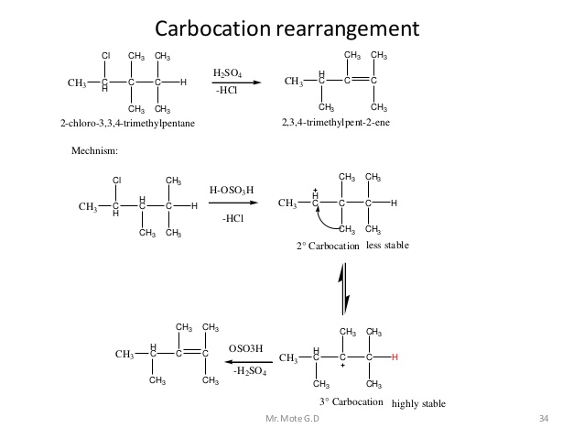

Slide 22
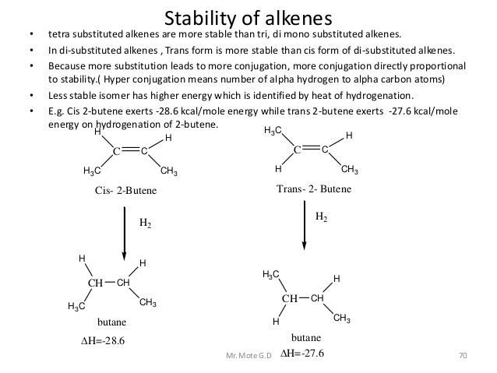

Slide 23
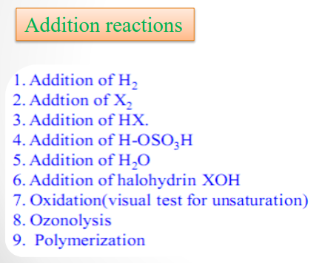
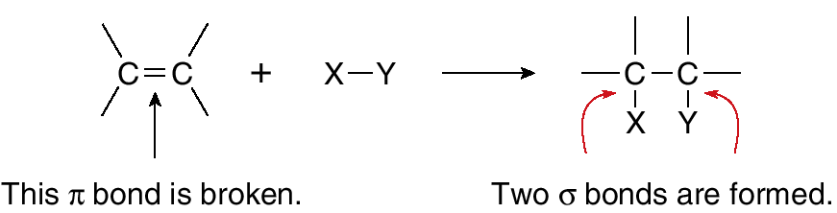
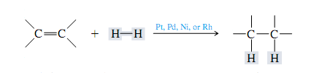

Addition of Hydrogen: Catalytic Hydrogenation
Example:

Slide 24
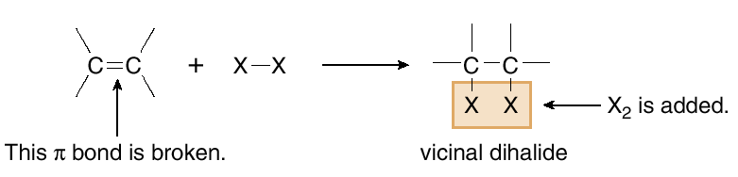

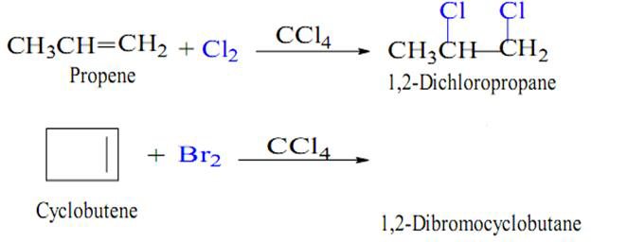
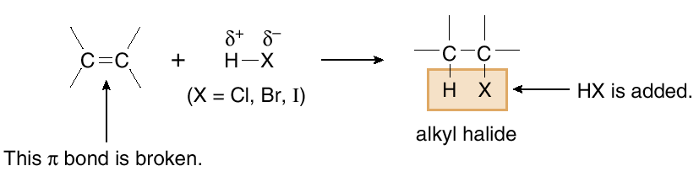

Addition of Halogens: Halogenation
Examples:
Addition of Hydrogen Halides: Hydrohalogenation

Slide 25
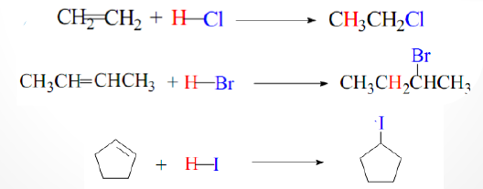
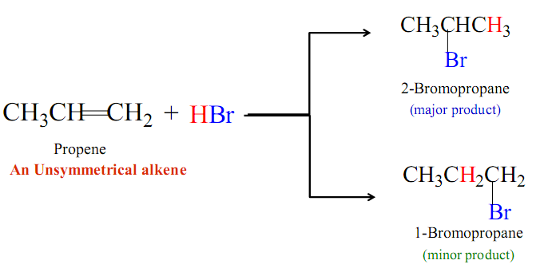
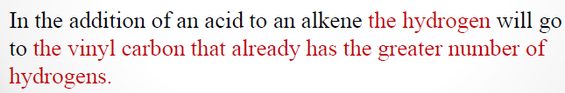
Examples:
Markovnikov’sRule
In, 1989 russian scientist morkonikov discovered this reaction

Slide 26
Mechanism:
Step:1
Proton adds on the terminal carbon atom of double bond the secondary carbocation is formed.
Step-2:
Addition of protons occurs on the middle carbon atom then primary carbocationis formed.

Slide 27
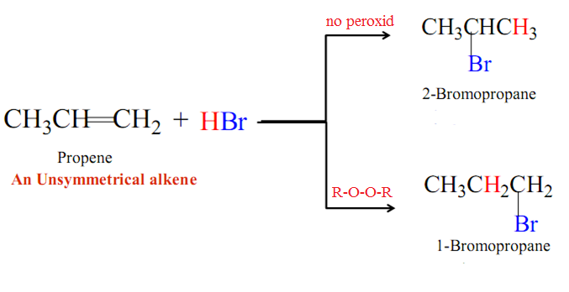

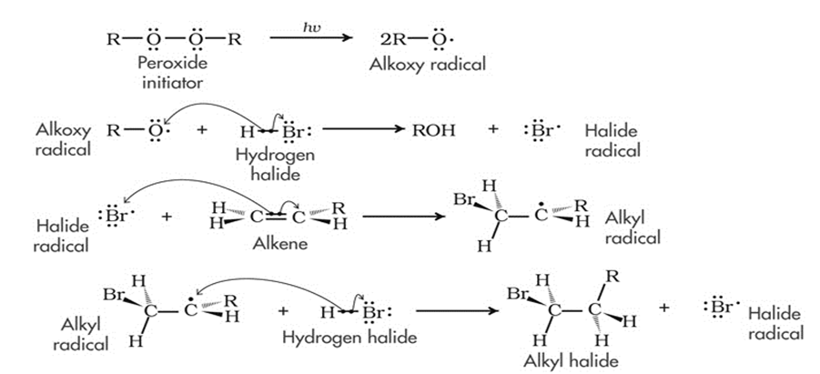
Anti Markovnikov’sRule
known as “ kharash effect/ peroxide effect.
Peroxide effect is observed with HBr only and not with HCl, HF, and HI..
Mechanism:

Slide 28
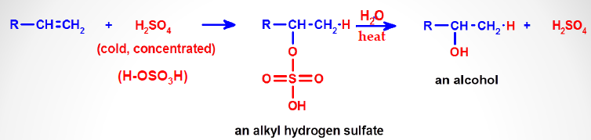
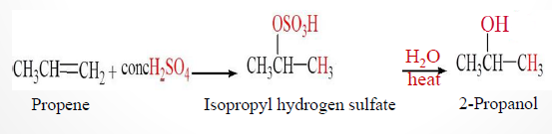
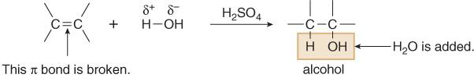
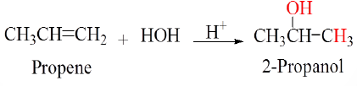
Addition of Sulfuric acid
Addition of Water : Hydration
Examples:

Slide 29
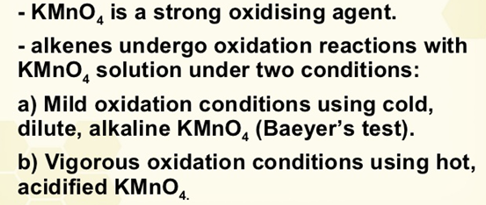
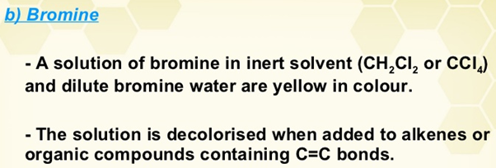






Slide 30


Slide 31


Slide 32


Slide 33




Slide 34


Slide 35


Slide 36


Slide 37


Slide 38


Slide 39


Slide 40


Slide 41


Slide 42

Diels-Alder reaction: 1928 otto diels and kurt alder discovered this reaction
It is a (4+2) cyclo addition reaction
This reaction is an addition reaction between a 1,3-diene and an alkene/ alkyne (dieonophile) to form a new ring.
Dienophile means diene loving
Diene: Diene are electron rich compounds. In the presence of electron releasing groups such as alkyl, phenyl or alkoxy groups.
Dienophile: Electron poor alkenes and alhyne . the good dienophile generally has one/more electron withdrawing groups (CHO, COOH, CN)
Diels- alder reaction is a thermal reaction. They form six membered rings.
Three pi-bonds broken and two new c-c sigma bonds and one new c-c pi-bond forms.
Conjugated diene and substituted alkene ( dienophile) to form cyclo hexane ring system.
Mechanism:

Slide 43

Alkynes:
alkenes are the class of organic compounds. They are made up of carbon and hydrogen atoms only and contains atleast one carbon-carbon triple bond. They do not have functional groups.
these compounds also known as unsaturated hydrocarbons.
its similar to alkenes
alkynes another name is Acetylene
Suffix “-yne”
The general formula of alkene is C_{n}H_{2n-2} where n: 2,3,4….
Alkenyl group:
Removal of one hydrogen atom from alkynes are called alkynyl group

